Slide 1
FDA-Approved Drugs
Tutorial

Slide 2
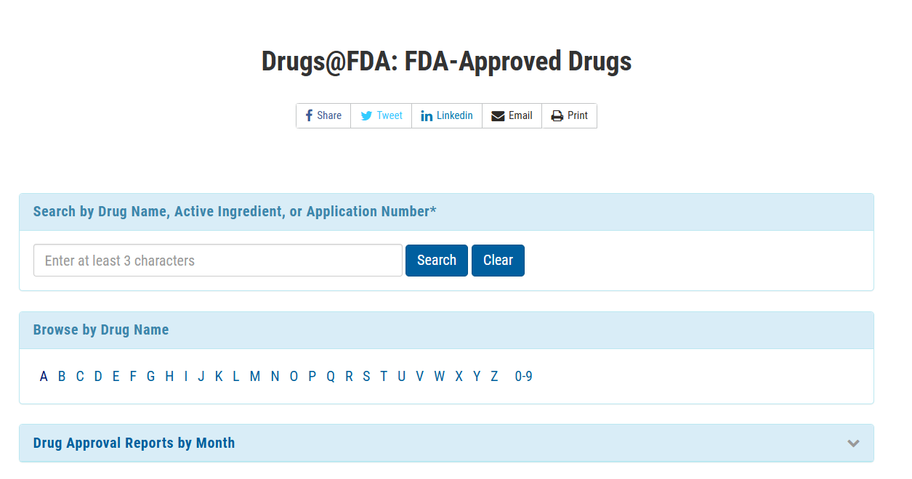
Enter the drug name in the search bar (for example, TYL for Tylenol)

Slide 3
Click on the letter below and this will list all FDA approved drugs in alphabetical order

Slide 4
Click on the arrow to browse approved reports. You can filter by date and view the data

